Slide 1
The Government’s Race Disparity Unit
Marcus Bell, Director, Race Disparity Unit

Slide 2
Race Disparity Audit - Transparency of Government data
Government collects a huge volume of data - on ethnicity we identified over 130 datasets including across education, employment, housing, health and criminal justice
Majority of Government data is already published - but can be difficult to find and interpret
Purpose of Audit to collect and publish data onto one transparent and accessible Government website
Project unprecedented in scope, scale and transparency

Slide 3
Ethnicity Facts and Figures
No design blueprint for the RDA - focus to meet data and digital quality standards and meet needs of variety of users
Engaged with community groups, academics, open data leaders and sector experts across the UK and Government to shape website
Website launched in October 2017 - 156 different topics by ethnicity
In excess of 115,000 visitors and more than 20 local examples of organisations using data to plan or effect change
Built on extensive user-testing and presented in a dispassionate way

Slide 4
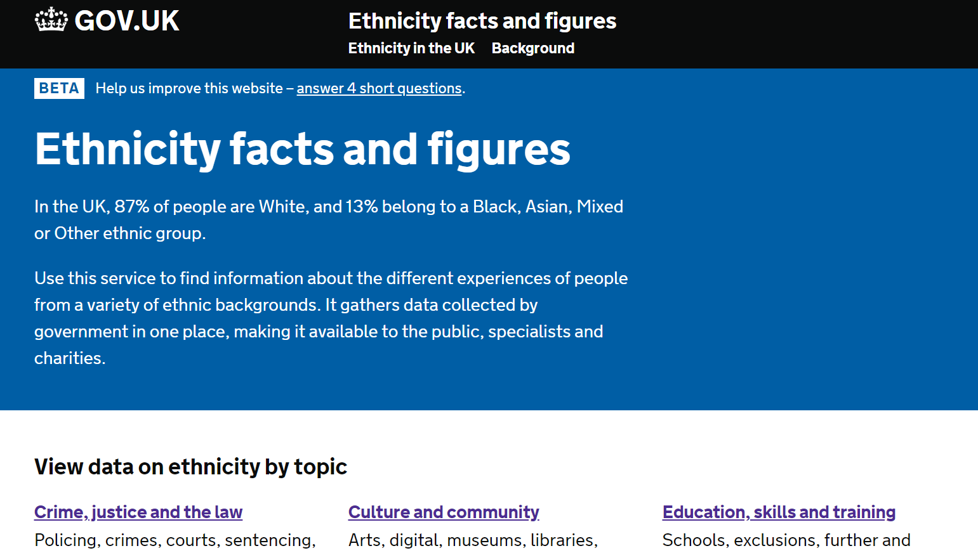

Slide 5
Data-driven policy
Launch of website followed by PM announcement of a data-driven policy package to explain or change ethnic disparities;
Launch of £90m Big Lottery programme to support disadvantaged young people into employment
Challenge areas focus to tackle low employment/high inactivity
Implement actions from Lammy Review in criminal justice
Launch of the Stakeholder Advisory Group
Review of application of Mental Health Act
Review of school exclusions

Slide 6
A game-changer?
Outcomes of opening up this data;
Shines a light on how ethnicity affects outcomes - and focus to improve outcomes where disparities are significant
Focuses on improving quality and harmonisation standards on the collation of ethnicity data - published in an accessible format
Challenges organisations across public, private and community sectors to consider why outcomes are different

Slide 7
What’s next?
Engage Departments to develop policies and programs to tackle disparities
Identify what works including data-driven decisions to tackle ethnic disparities
Publish further data and assess whether disparities are changing over time
Engage across sectors to understand the causes behind disparities
Harmonise the approach to ethnicity classification across Government

Slide 8
Ways to stay in touch
Sign up for monthly updates from us
Get in touch by emailing us at ethnicity@cabinetoffice.gov.uk
Let us know how you are using our data within your organisation

Slide 9
Q&A

